Slide 1
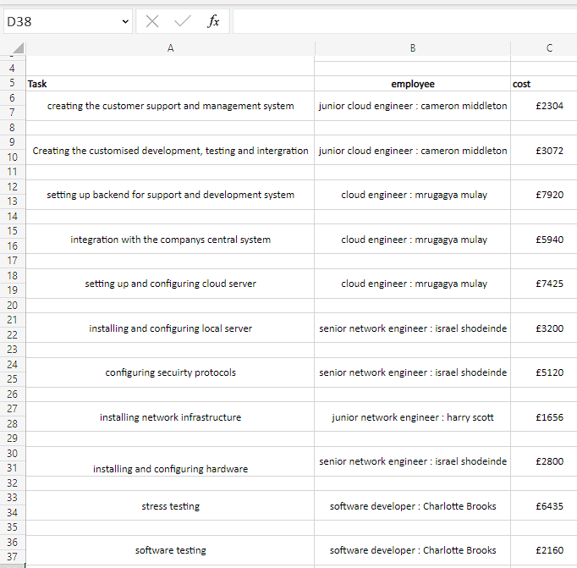
EXCEL

Slide 2
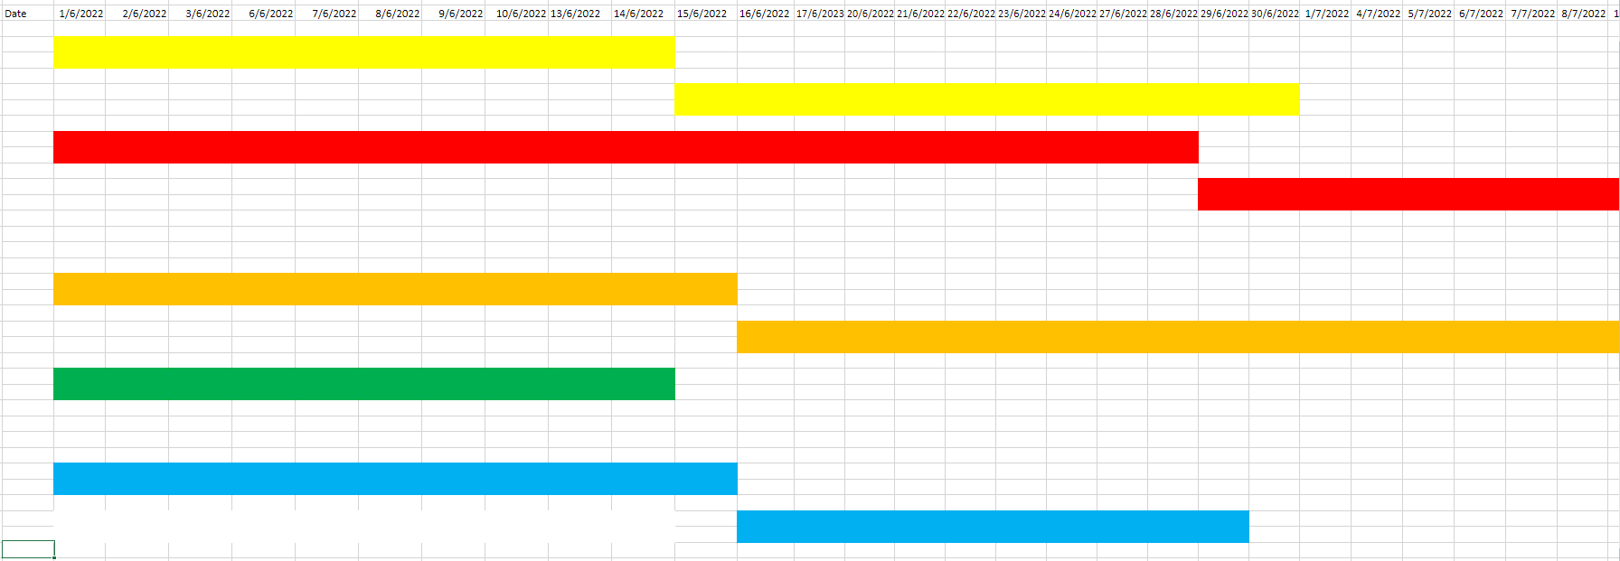
EXCEL

Slide 3
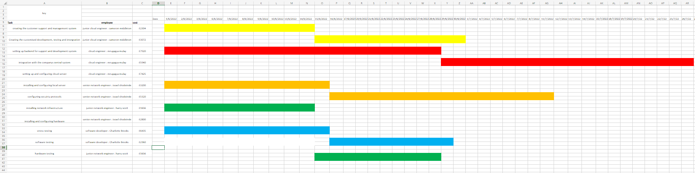
EXCEL

Slide 4
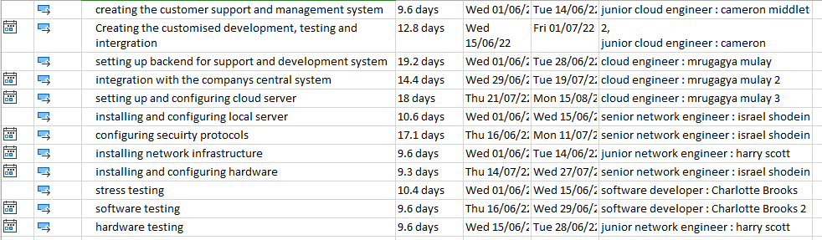
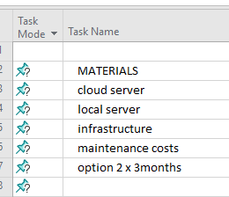
Microsoft project

Slide 5
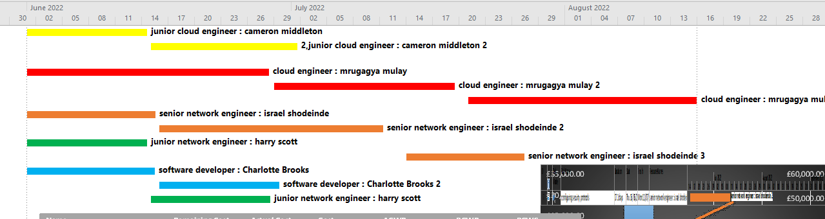
Microsoft project

Slide 6
Name | Remaining Cost | Actual Cost | Cost | ACWP | BCWP | BCWS
creating the customer support and management system | £2,457.60 | £0.00 | £2,457.60 | £0.00 | £0.00 | £0.00
Creating the customised development, testing and intergration | £3,276.80 | £0.00 | £3,276.80 | £0.00 | £0.00 | £0.00
setting up backend for support and development system | £8,448.00 | £0.00 | £8,448.00 | £0.00 | £0.00 | £0.00
integration with the companys central system | £6,336.00 | £0.00 | £6,336.00 | £0.00 | £0.00 | £0.00
setting up and configuring cloud server | £7,920.00 | £0.00 | £7,920.00 | £0.00 | £0.00 | £0.00
installing and configuring local server | £3,392.00 | £0.00 | £3,392.00 | £0.00 | £0.00 | £0.00
configuring secuirty protocols | £5,472.00 | £0.00 | £5,472.00 | £0.00 | £0.00 | £0.00
installing network infrastructure | £1,766.40 | £0.00 | £1,766.40 | £0.00 | £0.00 | £0.00
installing and configuring hardware | £2,976.00 | £0.00 | £2,976.00 | £0.00 | £0.00 | £0.00
stress testing | £2,496.00 | £0.00 | £2,496.00 | £0.00 | £0.00 | £0.00
software testing | £2,304.00 | £0.00 | £2,304.00 | £0.00 | £0.00 | £0.00
hardware testing | £1,766.40 | £0.00 | £1,766.40 | £0.00 | £0.00 | £0.00
 | £0.00 | £0.00 | £0.00 | £0.00 | £0.00 | £0.00
 | £0.00 | £0.00 | £0.00 | £0.00 | £0.00 | £0.00
MATERIALS | £0.00 | £0.00 | £0.00 | £0.00 | £0.00 | £0.00
cloud server | £1,950.00 | £0.00 | £1,950.00 | £0.00 | £0.00 | £0.00
local server | £12,500.00 | £0.00 | £12,500.00 | £0.00 | £0.00 | £0.00
infrastructure | £3,200.00 | £0.00 | £3,200.00 | £0.00 | £0.00 | £0.00
maintenance costs | £5,200.00 | £0.00 | £5,200.00 | £0.00 | £0.00 | £0.00
option 2 x 3months | £32,250.00 | £0.00 | £32,250.00 | £0.00 | £0.00 | £0.00
 | £0.00 | £0.00 | £0.00 | £0.00 | £0.00 | £0.00

Slide 7
